Slide 1

Episodic Sarsa with Function Approximation
Notes:
1

Slide 2
Objectives
Understand how to construct action-dependent features for approximate action values
Explain the update for Episodic Sarsa with function approximation
Explain the update for expected Sarsa with function approximation.
Explain the update for Q-learning with function approximation.
Episodic Sarsa with Function Approximation
2
Notes:
2

Slide 3
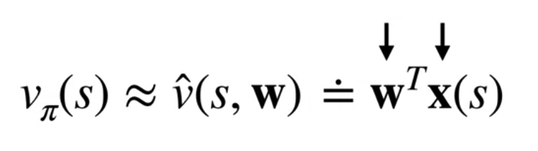
Episodic Sarsa with Function Approximation
The State-values to action-values
The value function approximation has two components, a weight vector and a feature vector.
In a given state, the value estimate is the dot product between these two components.
Episodic Sarsa with Function Approximation
3
Notes:
3

Slide 4
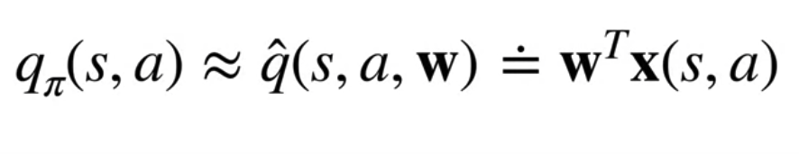
Episodic Sarsa with Function Approximation
The State-values to action-values
To move from TD to Sarsa, we need action value functions.
The feature representation has to represent actions as well..
Episodic Sarsa with Function Approximation
4
Notes:
4

Slide 5
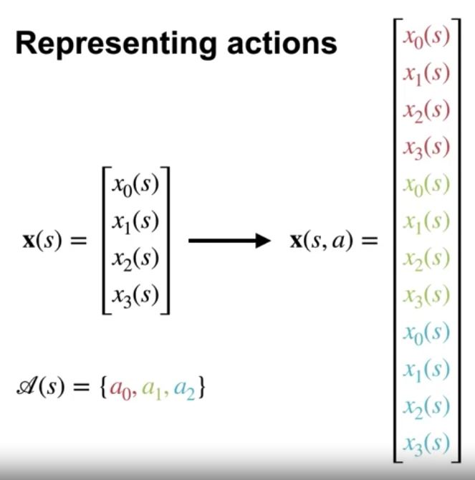
Episodic Sarsa with Function Approximation
Example:
There are four features and three actions.
The four features represent the state you are in.
But we want to learn a function of both states and actions.
We can do this by repeating the four features for each action.
Episodic Sarsa with Function Approximation
5
Notes:
5

Slide 6
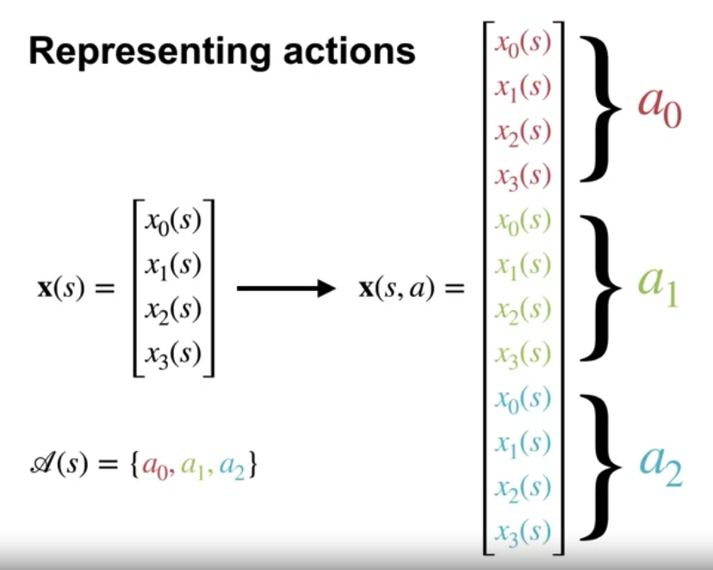
Episodic Sarsa with Function Approximation
Example:
The feature vector has 12 components.
Here, each segment of four features corresponds to a separate action.
We call this feature representation stacked because the weights for each action are stacked on top of each other.
Episodic Sarsa with Function Approximation
6
Notes:
6

Slide 7
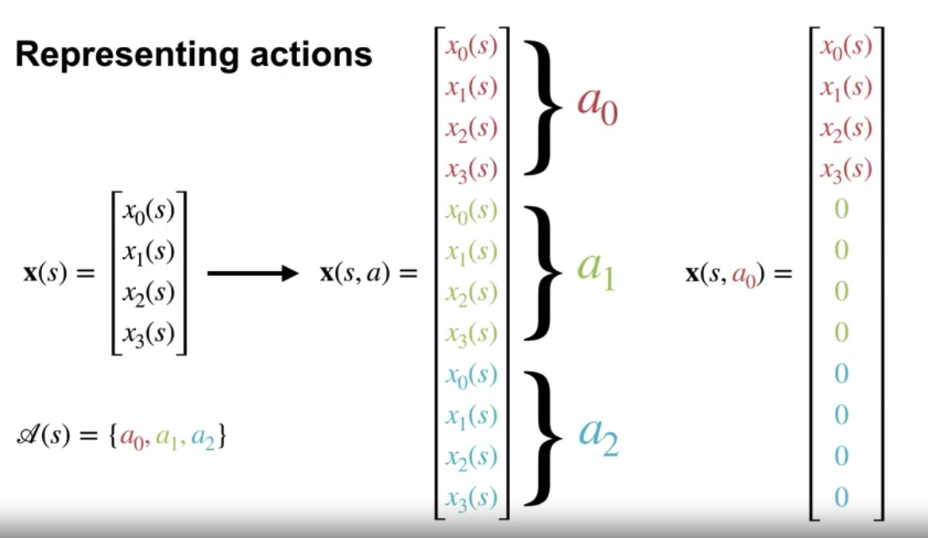
Episodic Sarsa with Function Approximation
Example:
Only the features for the specified action will be active, while though for the other actions will be set to 0
Episodic Sarsa with Function Approximation
7
Notes:
7

Slide 8
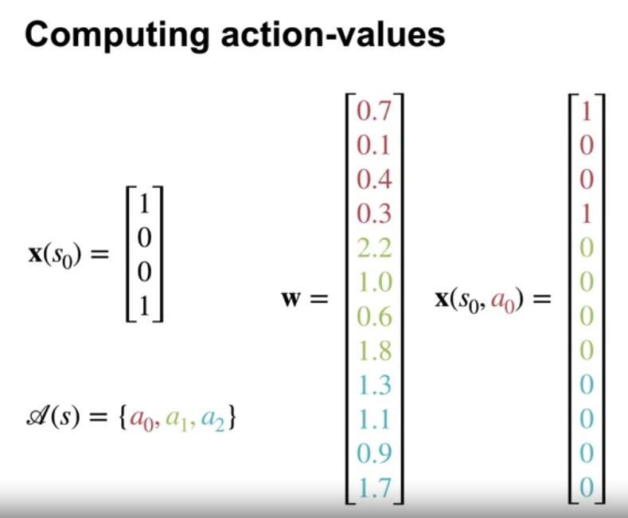
Episodic Sarsa with Function Approximation
Example: calculate the action values from a given state
There are four features and three actions.
The weight factor looks like figure.
With stacked features, we get the following feature vector for action zero in state s.
We 0 out the features for the other actions.
Episodic Sarsa with Function Approximation
8
Notes:
8

Slide 9
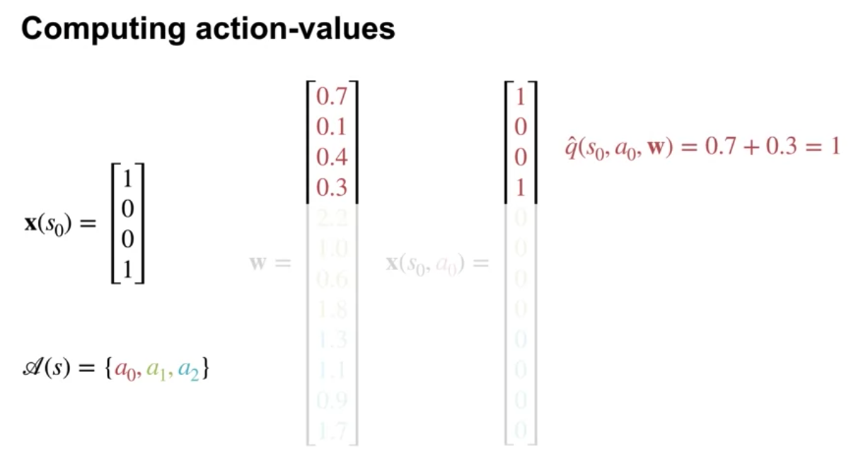
Episodic Sarsa with Function Approximation
Example: calculate the action values from a given state
We extract the segment of the weight vector corresponding to each action.
Episodic Sarsa with Function Approximation
9
Notes:
9

Slide 10
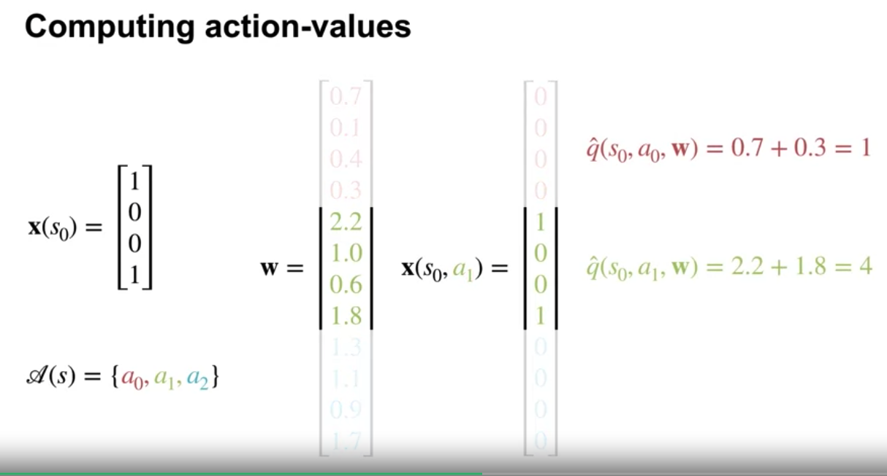
Episodic Sarsa with Function Approximation
Example: calculate the action values from a given state
The action values are then the dot products between each segment of the weight vector and the feature vector.
Episodic Sarsa with Function Approximation
10
Notes:
10

Slide 11
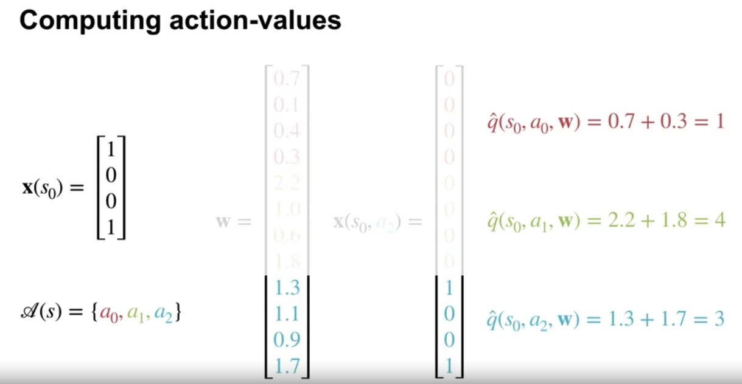
Episodic Sarsa with Function Approximation
Example: calculate the action values from a given state
Episodic Sarsa with Function Approximation
11
Notes:
11

Slide 12
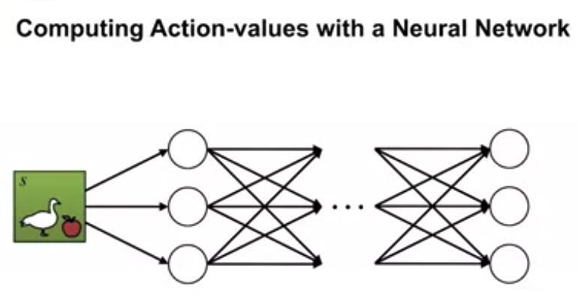
Episodic Sarsa with Function Approximation
Computing action-values with a Neural Network
The common way to represent action values with a neural network is to generate multiple outputs, one for each action value.
Episodic Sarsa with Function Approximation
12
Notes:
12

Slide 13
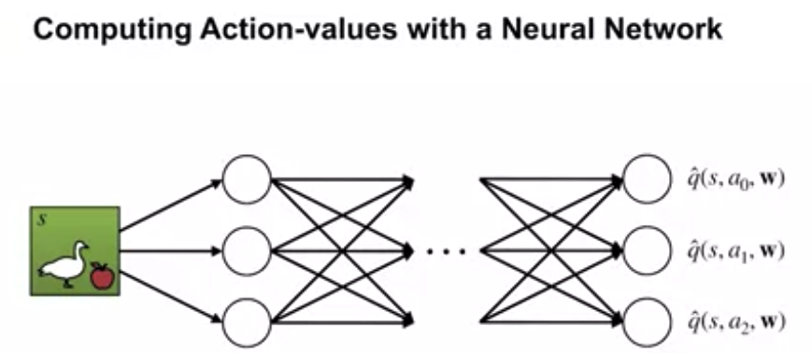
Episodic Sarsa with Function Approximation
Computing action-values with a Neural Network
The neural network inputs the state and the last hidden layer produces the state features.
Each action value is computed from an independent set of weights using those state features.
Episodic Sarsa with Function Approximation
13
Notes:
13

Slide 14
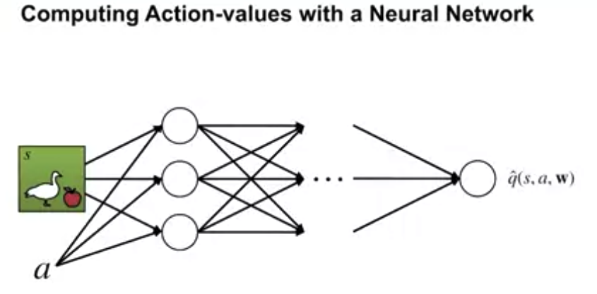
Episodic Sarsa with Function Approximation
Computing action-values with a Neural Network
We would input both the state and the action to the network. There would only be one output.
The approximate action value for that state and action.
We can do something similar with tile coating by passing both the state and action as input
Episodic Sarsa with Function Approximation
14
Notes:
14

Slide 15
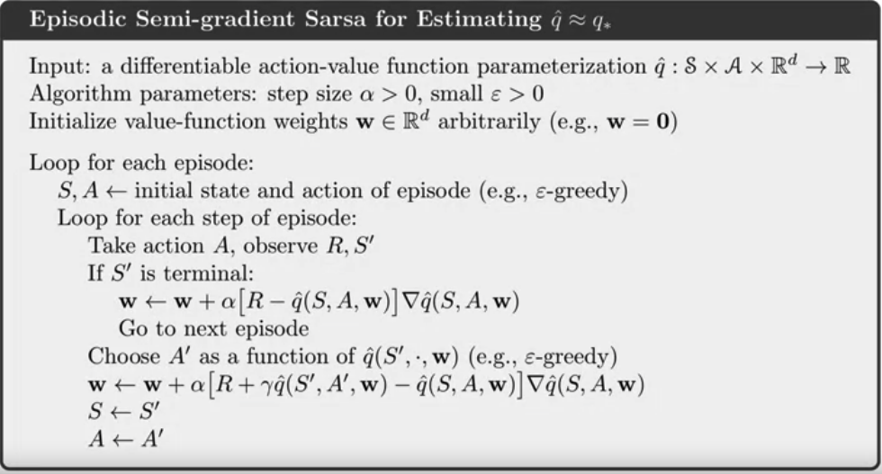
Episodic Sarsa with Function Approximation
Sarsa for control of function approximation
Episodic Sarsa with Function Approximation
15
Notes:
15

Slide 16
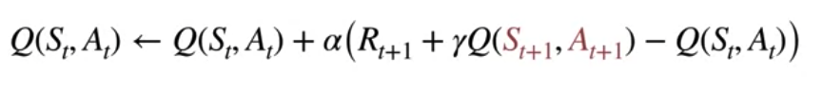
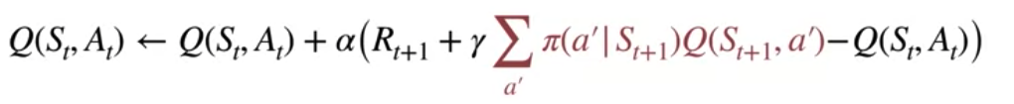
Episodic Sarsa with Function Approximation
From Sarsa to Expected Sarsa
Sarsa: Sarsa's update target includes the action value for the next state in action.
Expected Sarsa: Sum over the action values weighted by their probability under the target policy.
Episodic Sarsa with Function Approximation
16
Notes:
16

Slide 17
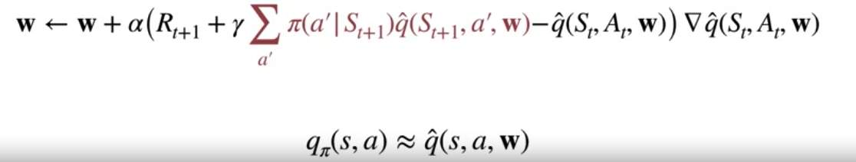
Expected Sarsa with Function Approximation
The update for Sarsa with function approximation.
The Expected Sarsa:
We compute the action values from our weight vector for every action in the next state. Then we compute this expectation under the target policy.
Episodic Sarsa with Function Approximation
17
Notes:
17

Slide 18
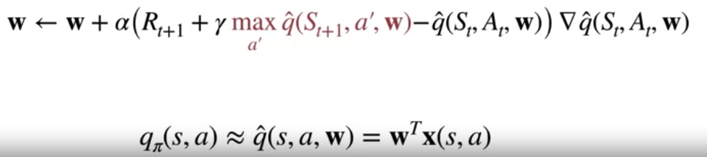
Expected Sarsa to Q-Learning
The Expected Sarsa:
We compute the action values from our weight vector for every action in the next state. Then we compute this expectation under the target policy.
Q-Learning: use the max in place of the expectation
Episodic Sarsa with Function Approximation
18
Notes:
18

Slide 19
Sarsa Example
The demonstrates how SARSA can be used to learn the optimal policy for a grid world environment by updaating the Q-values based on observed rewards and subsequent actions taken.
Episodic Sarsa with Function Approximation
19
Notes:
19

Slide 20
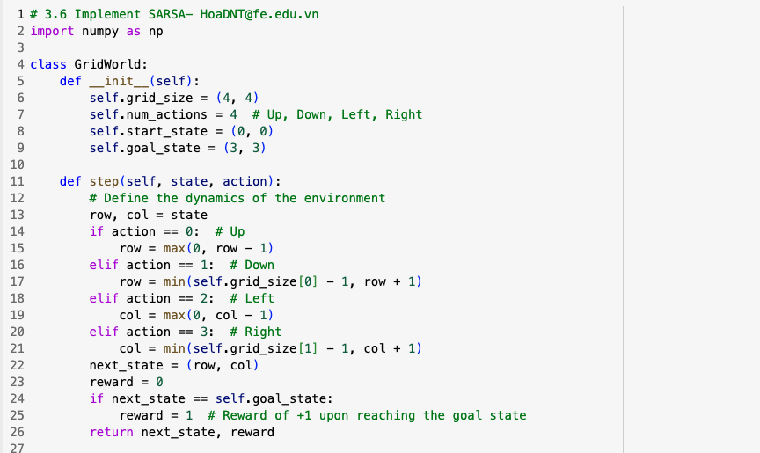
Sarsa Example
Episodic Sarsa with Function Approximation
20
Notes:
20

Slide 21
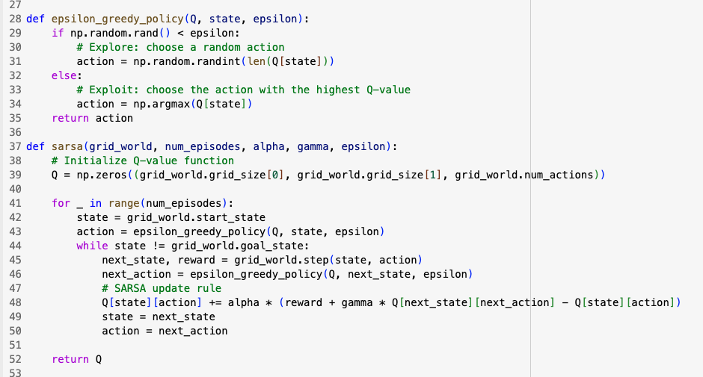
Sarsa Example
Episodic Sarsa with Function Approximation
21
Notes:
21

Slide 22
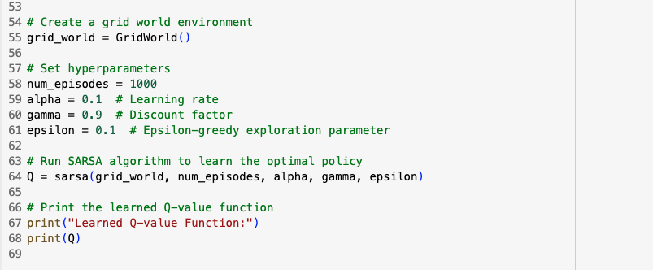
Sarsa Example
Episodic Sarsa with Function Approximation
22
Notes:
22

Slide 23
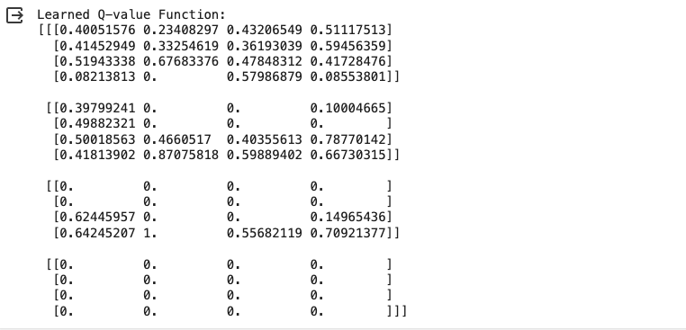
Sarsa Example
Episodic Sarsa with Function Approximation
23
Notes:
23

Slide 24
Summary
Understand how to construct action-dependent features for approximate action values
Explain the update for Episodic Sarsa with function approximation
Explain the update for expected Sarsa with function approximation.
Explain the update for Q-learning with function approximation.
Episodic Sarsa with Function Approximation
24

Slide 25
Q & A
Episodic Sarsa with Function Approximation
25

